Slide 1
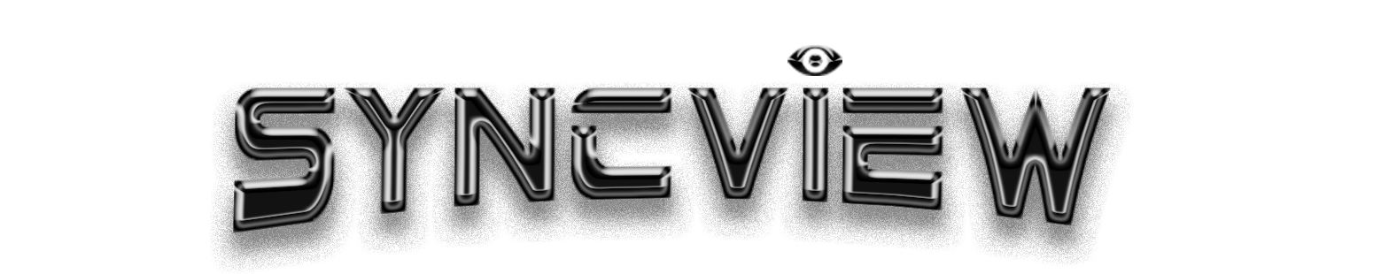
By Penny, Julian, Jarit, & Michael

Slide 2
Meet the Team
/*
Penny Bibb, Freshman Computer Science Major, 22
Fun Opinion: Horizon Zero Dawn should have been 2017 GOTY.
Julian Palmisano, Freshman Computer Science Major, 19
Fun Fact: My favorite food is lamb.
Michael Boutin, Freshman Computer Science Major, 18
Fun Fact: I love cats. /\_/\
( o.o )
> ^ <
Jarit Kratz, Sophomore Computer Science Major, 21
Fun Fact: I have lived in New Hampshire for my entire life.
*/

Slide 3
The Birth of SyncView
Why?
We wanted a reliable and simple application where we were able to share videos simultaneously with friends including things such as:
Choice of videos; done with a server where users are able to upload and select videos to sync with their friends.
Chatting with other participants; we wanted this so users could watch videos as well as keep in touch all in the same application.
A solid and modern UI design; we did this using Photoshop and WinForms for ease of usability.
MB
Notes:
Michael

Slide 4


Planning Tools
How we kept each group member’s tasks accounted for:
Discord
We used Discord as our main method of communication. This was easiest for us because we were able to create a server with different channels for each area of the project. These consisted of channels such as Meeting times / Meeting info, planning, and using Discord to log everyone's Git contributions.
HacknPlan
HacknPlan was a separate website we also used to plan out our project and was more for the little things like bug fixes and specific tasks for each member. Some of these look like moderation tools and UI fixes.
MB
Notes:
Michael

Slide 5
Why WinForms?
We used WinForms for this project because not only does it allow us to create graphics but it also has support from LibVLCSharp, which we utilised for video playback.
Alternatives (And Why We Never Used These)
WPF
WinForms is simpler and easier to use for basic UI design than WPF.
Based on forms and controls, WinForms is a more traditional approach to UI in comparison to WPF.
GTK
Requires installation on Windows unlike WinForms.
Has a standalone designer for MonoDevelop, whereas that of WinForms is integrated with Visual Studio.
QT
Requires the use of C++; for this project we used C# because we have used it all semester.
Not as easy to use compared to WinForms.
JK
Notes:
Jarit

Slide 6
Libraries Used
HtmlAgilityPack is a library we used in order to parse the web server’s response to get the url links (media selection).
We used LibVLCSharp for video playback, this allowed for smooth streaming even with high definition and high bitrate.
We used SeriLog for logging (good for debugging!).
SVCommon (SyncView Common) is our common library.
We used Yggdrasil for its gameserver functions to help on the server side.
JP
Notes:
Julian : UI, Libraries

Slide 7

Features Of SyncView
Effortless Video Syncing
Chat Between Users 💬
Play and Pause Functionality ▶︎ ||
Fast Forward and Rewind ◁◁ ▷▷
Volume Control
Custom and Random Usernames
MB
Notes:
Michael

Slide 8
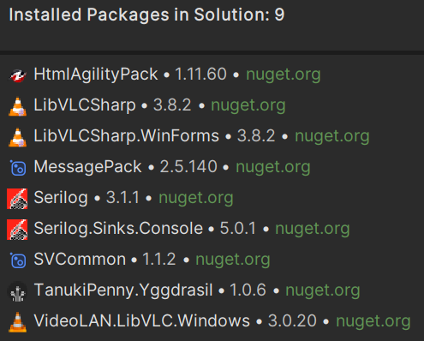

Use of Nuget
We uploaded our own Nuget packages to help manage our dependencies across multiple projects. Without this it would have been a much bigger pain doing that.
Our packages:
SVCommon
TanukiPenny.Yggdrasil
PB
Notes:
Penny

Slide 9
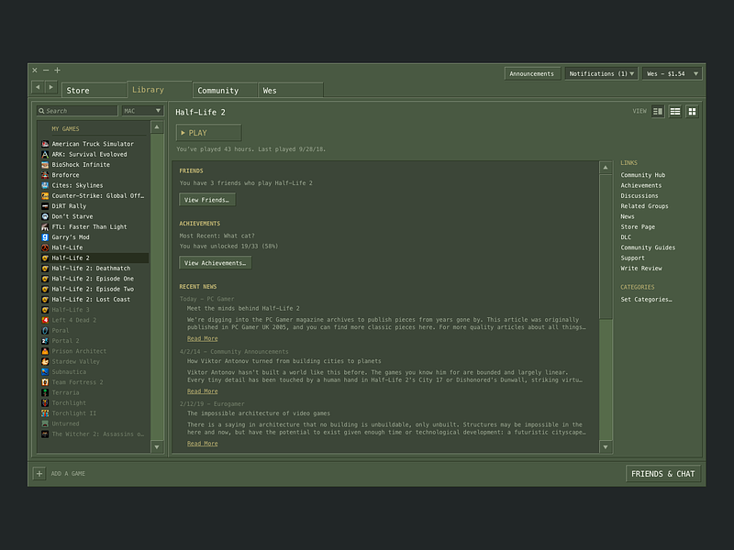
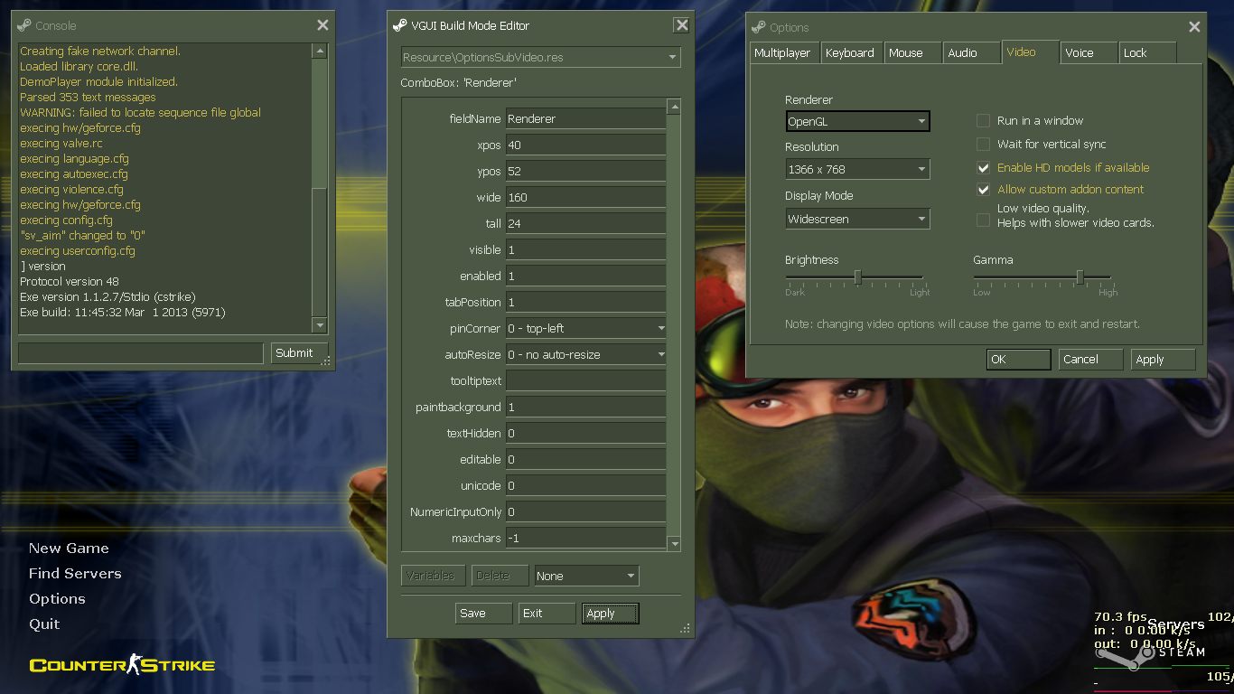


UI Design
For the interface design we used Photoshop and the built in Visual Studio tools.
We took color inspiration from VGUI using these images:
JP
Notes:
Julian

Slide 10
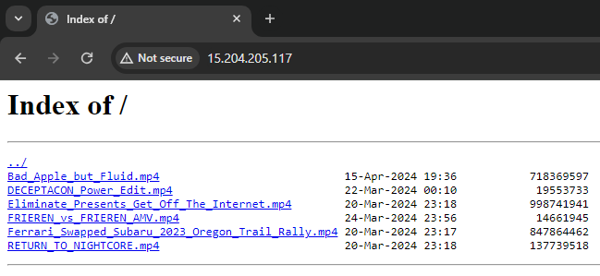
Server Strategy
SVServer (our code)
Is source of truth
Keeps track of current state
Paused/Playing
Who is host
What Media is playing
Current time in media
Forwards events to users
Time sync
Media change
Pause/Play
Sends events from server
User join/leave
Host Change
Nginx (open source web server)
Hosts video files
Basic Static page of direct links
PB
Notes:
Penny

Slide 11
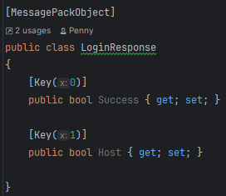
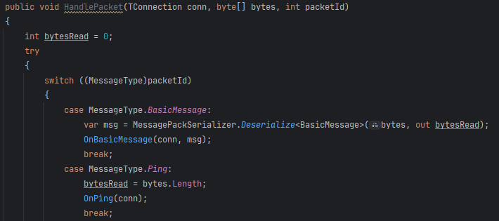
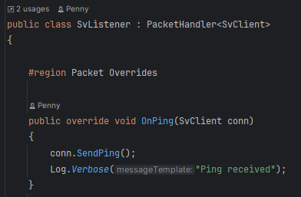
Networking Design
Raw Tcp Sockets
Used Yggdrasil (Open source game server library)
Common class library for networking components
Packet Id Enum
Packet Classes
Packet Handler
PB
Notes:
Penny

Slide 12
Challenges
First, we had to decide between integrating a hosting system into the app itself or running the program using an external server.
Second, we had to figure out how to send and receive messages through a chat system.
Furthermore, we had to figure out which libraries to use for specific functions within the project.
Finally, we decided to stick to using a static web server to serve video files due to the complexities of using Youtube.
JK
Notes:
Jarit

Slide 13
Future Growth
Although we are highly satisfied with what we were able to accomplish in the given time frame, we acknowledge that there is much room for improvement.
We plan to switch from WinForms to WPF(C#) or possibly to QT(C++).
We would also like users to be able to select videos from YouTube and not just locally.
Other miscellaneous features like chat emotes and higher user count are additional things we would like to implement.
Further development of UI and art.
Possibly a website.
JP
Notes:
Julian

Slide 14



What We Learned
We learned that using C# and WinForms for our project is a lot easier than using any other programming language / tool, as they integrate seamlessly into the program we made. In addition to that, we learned how chat messaging and video sharing work. We also learned how to import files from the hard drive using Visual Studio / WinForms into our application (no YouTube, though). We even learned how servers and libraries work.
JK
Notes:
Jarit

Slide 15
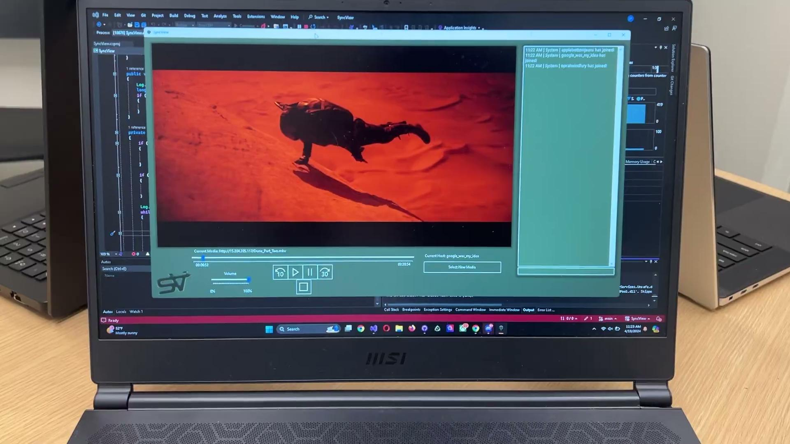
Demo Timeeee!
PB
Notes:
Penny

Slide 16

Thank you for your time
PB
Notes:
Penny

